Slide 1
Pepper in Job Interviews
Presented by: Charbel Hajj
Gio Nassif Rizk
Joseph Mattar
Charbel Sleiman Daoud
Georges Mansour
Presented to: Dr. Elie Saad

Slide 2
Table of contents
01
02
03
04
Background
Introduction
Our Project
Real World Use Cases
05
06
Benefits
Challenges
07
Choregraph Code
08
Conclusion
Page 2

Slide 3
01
Introduction
Page 3

Slide 4
Pepper Capabilities
Natural human interaction
Emotion recognition
Engaging communication
Page 4

Slide 5
02
Background
Page 5

Slide 6
History of Pepper Robot
2014
2015
2018
2021
First time introduced by SoftBank
Sold the first 1000 units in 60 seconds
12 000 robots sold in Europe
Pause of production due to weak demand
Page 6

Slide 7
Overview on Pepper Robot
Key Features | Human-like design and interaction
 | Cameras, microphones, touch screen
 | Ability to detect facial expressions
Applications in industries | Customer service, healthcare, education
Potential in HR | Handling repetitive tasks
 | Systemic candidate assessments
Page 7

Slide 8
03
Real World Use Cases
Page 10

Slide 9
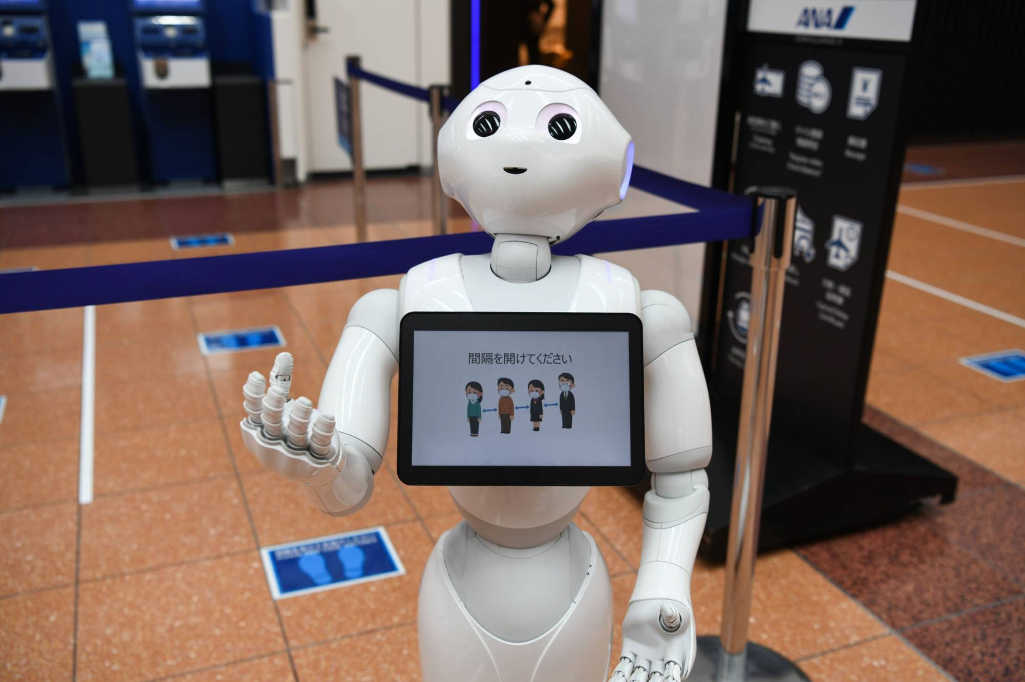
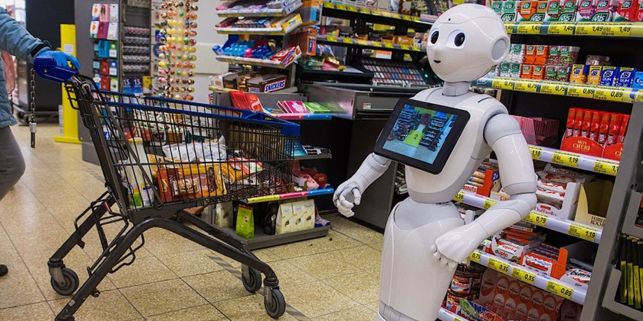
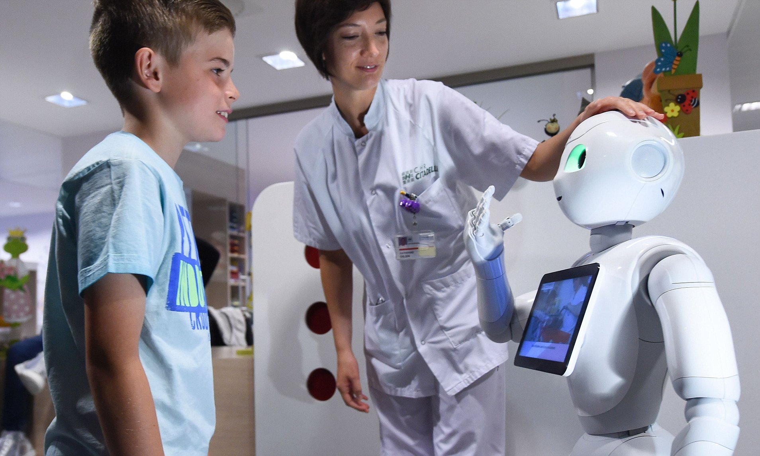
Real World Use Cases
Career Fairs
Retail Sectors
Healthcare
Mock interviews and company information sharing
Provide product information and personalized recommendations
Assist with patients' check-ins, provide health education and offer companionship
Page 11

Slide 10
04
Our Project
Pepper HR Assistant
Page 10

Slide 11
In this project, we are introducing Pepper, the HR Employee Assistant. Pepper is designed to support supervisors by taking over basic tasks, allowing them to focus on more critical responsibilities.
Page 11

Slide 12
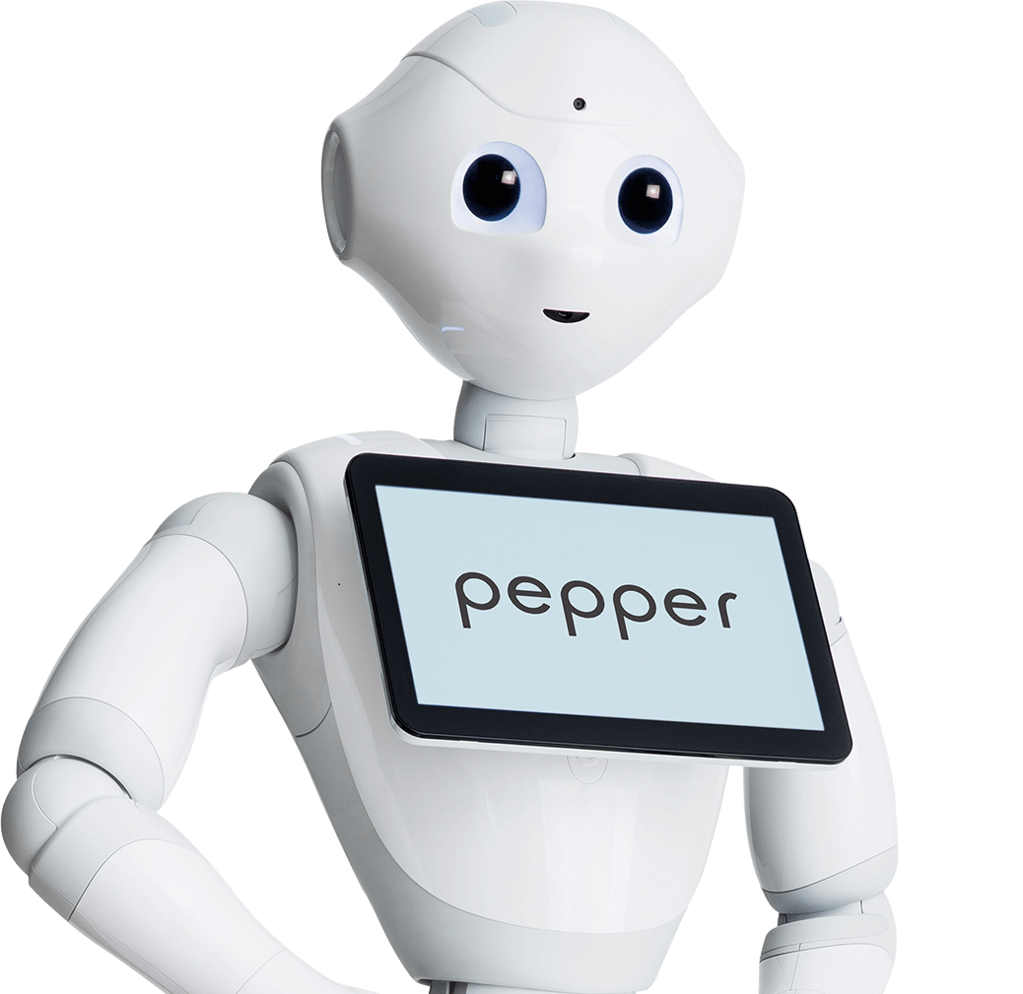
Pepper’s Primary Duties
Greeting applicants warmly upon arrival
Guiding applicants to the appropriate rooms
Asking basic questions to streamline initial recruitment stages
Dismissing applicants when the interview concludes
Page 12

Slide 13
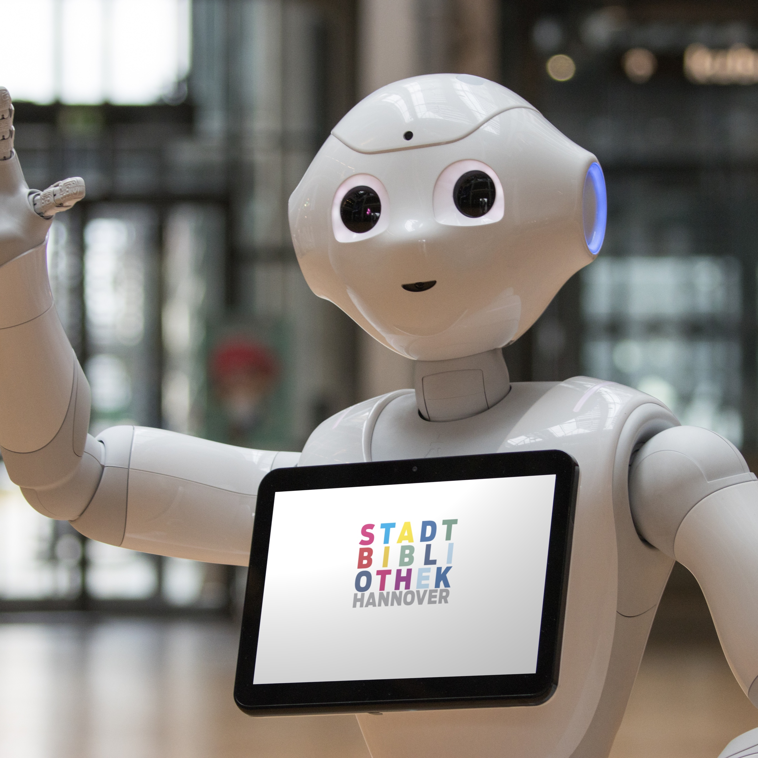
Greeting and Guiding
Stationed at the main building entrance to assist applicants
Detects and interacts with individuals entering for job interviews
Records names and cross-references with the interview database
Guides applicants to the appropriate interview room
Ensures applicants are seated comfortably
Begins the interview process by asking initial basic questions
Page 13

Slide 14
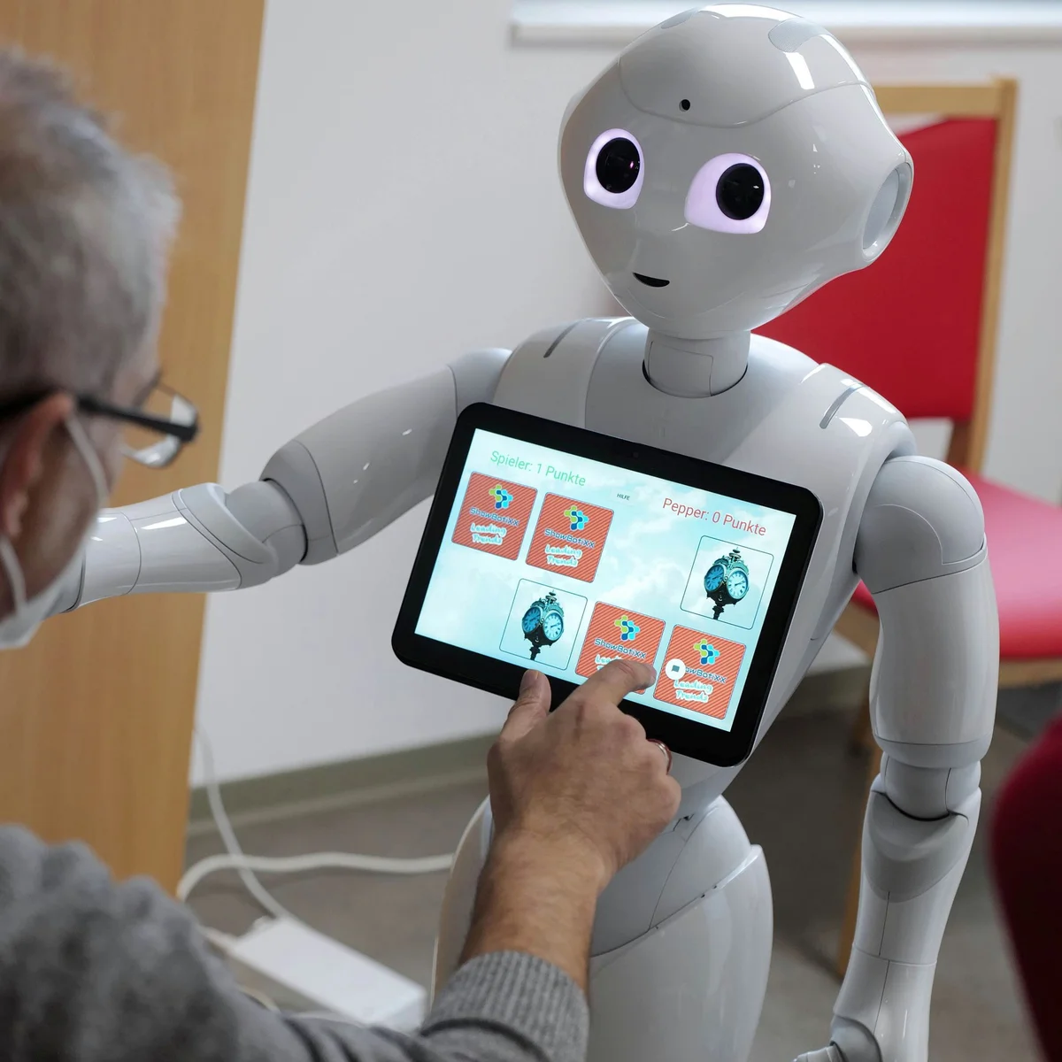
Assessing Skills
Assesses applicant’s knowledge and experience through a quiz
Supervisor prepares the quiz and assigns it to Pepper
Pepper administers the quiz and collects the answers
Stores responses and generates a score
Page 14

Slide 15
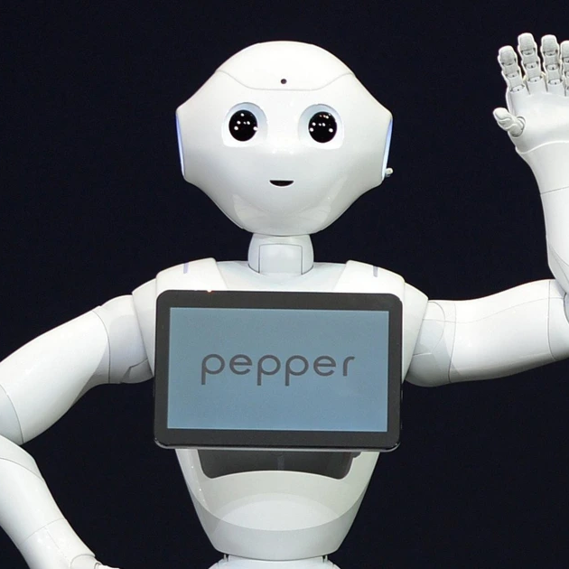
Dismissing Applicants
Thanks the applicant for their time and participation
Ask for feedback for future improvements
Notify the supervisor about the end of the interview
Wishes the applicants good luck and bids them farewell
Page 15

Slide 16
05
Challenges
Page 16

Slide 17
Challenges
Technical Difficulties
Resource Limitations
Data Handling Issues
Some functions are not working as intended.
Lack of a debugging console
Limited resources and troubleshooting guides
Problems with implementing the text input function and ensuring Pepper saves the data correctly
Page 17

Slide 18
06
Benefits
Page 18

Slide 19
Benefits
Consistency
Ensures every applicant is asked the same set of questions in the same manner, creating a uniform interview experience
Benefits
Objectivity
Evaluates applicants based solely on their responses and behavior, removing bias
Improved Efficiency
Handles repetitive tasks like pre-screening and data collection, allowing human supervisors to focus on more critical responsibilities
Page 19

Slide 20
Benefits
Availability
Available at any time to assist applicants
Benefits
Speed
Can quickly and accurately evaluate user input
Cost Effective
Reduces the need for additional staff during initial interview stages
Page 20

Slide 21
07
Choregraph Code
Page

Slide 22
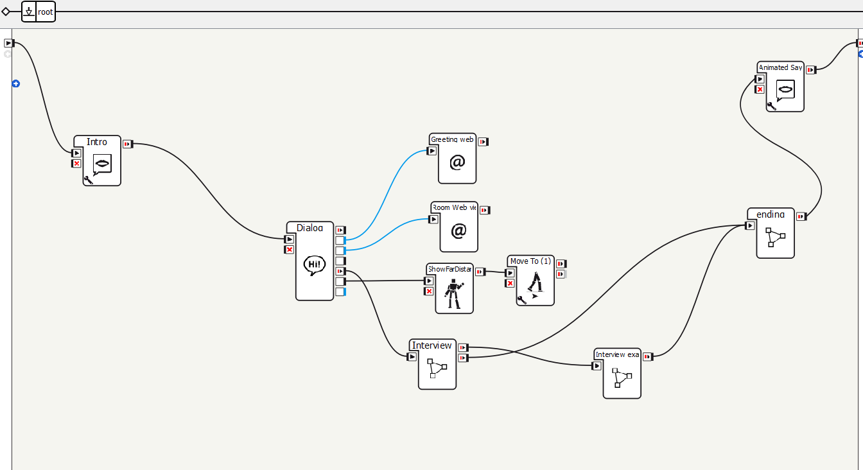
Choregraph Code
Page

Slide 23
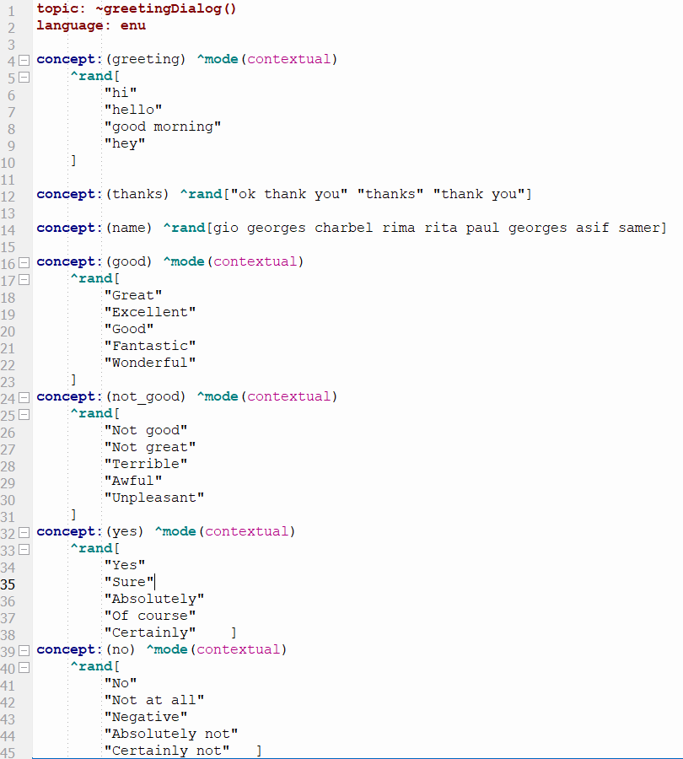
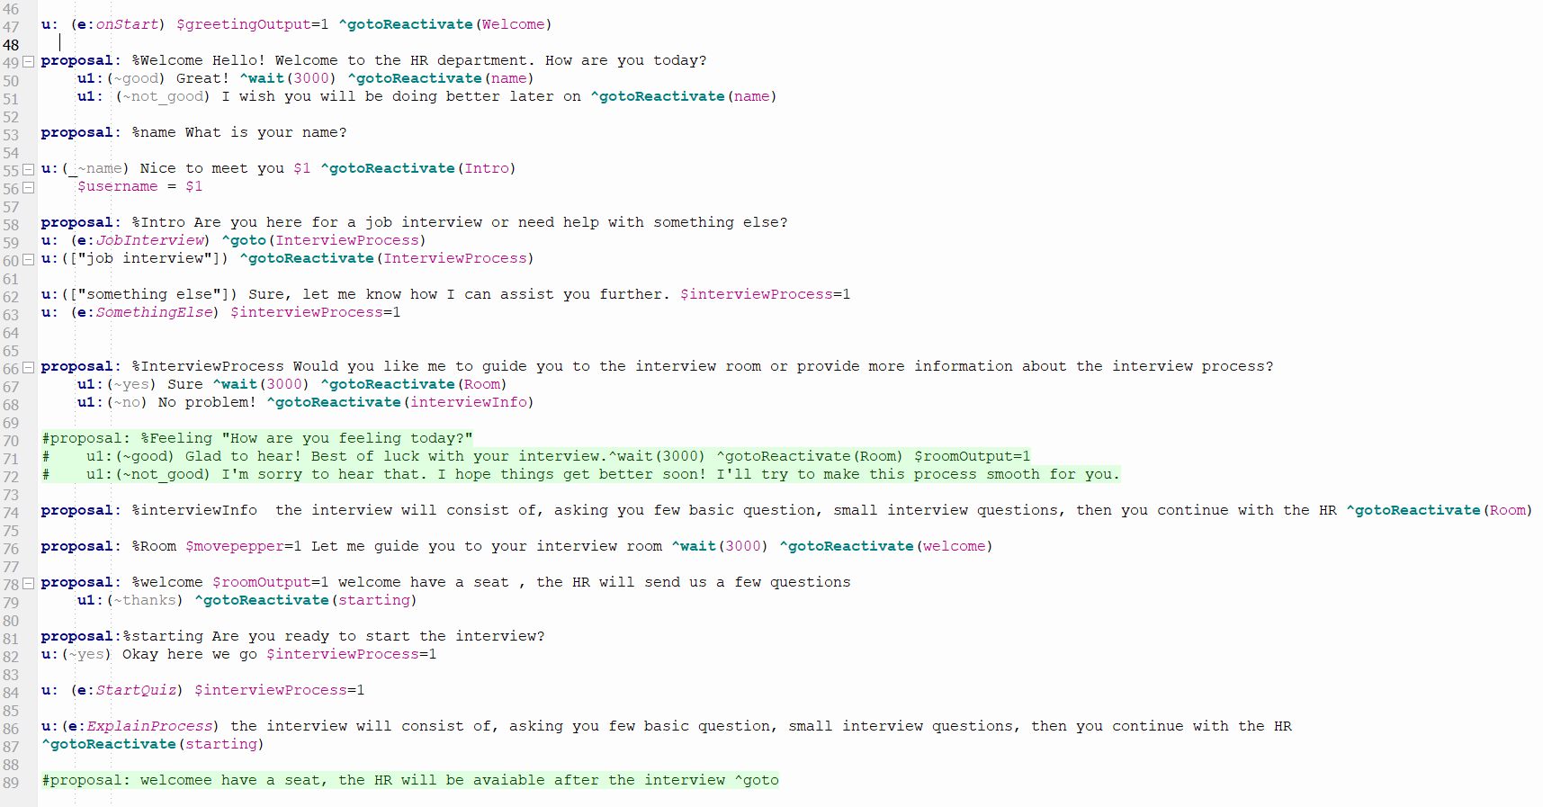
Choregraph Code
Page

Slide 24
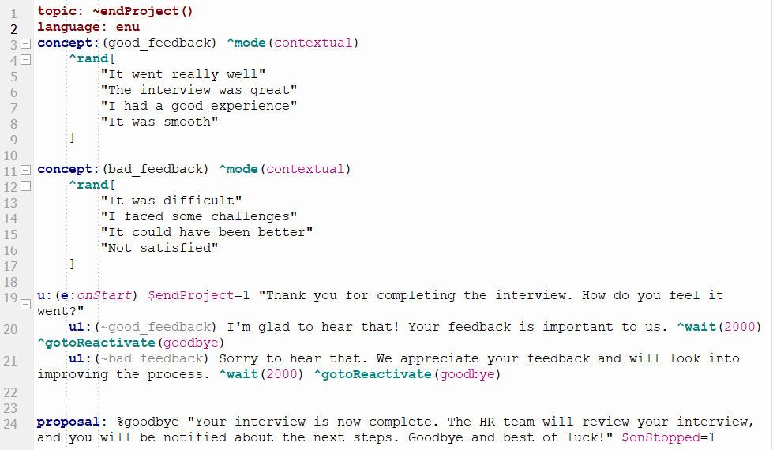
Choregraph Code
Page

Slide 25
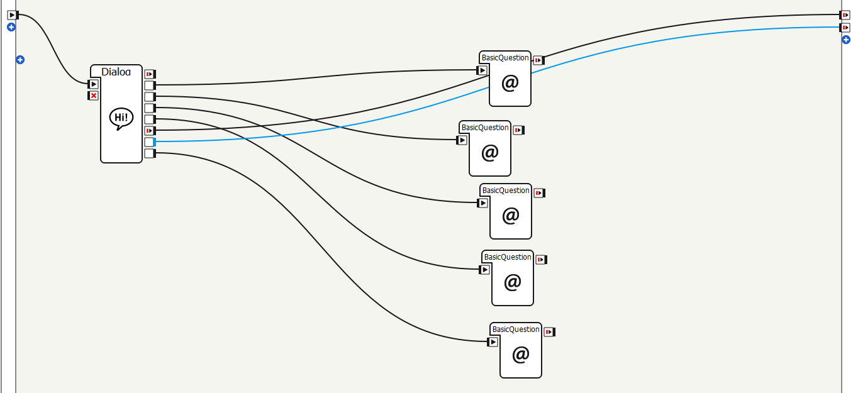
Choregraph Code
Page

Slide 26
Choregraph Code
Page

Slide 27
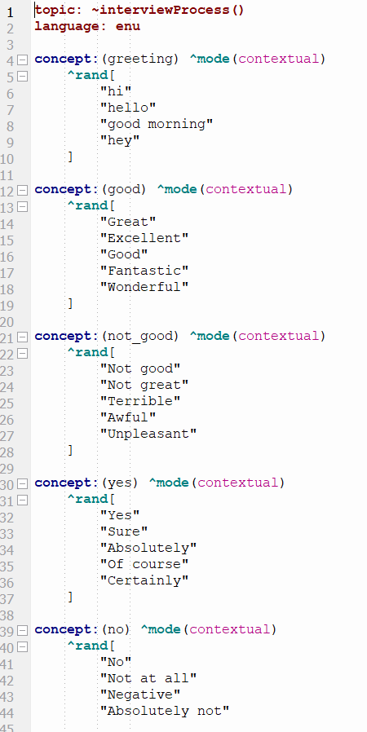
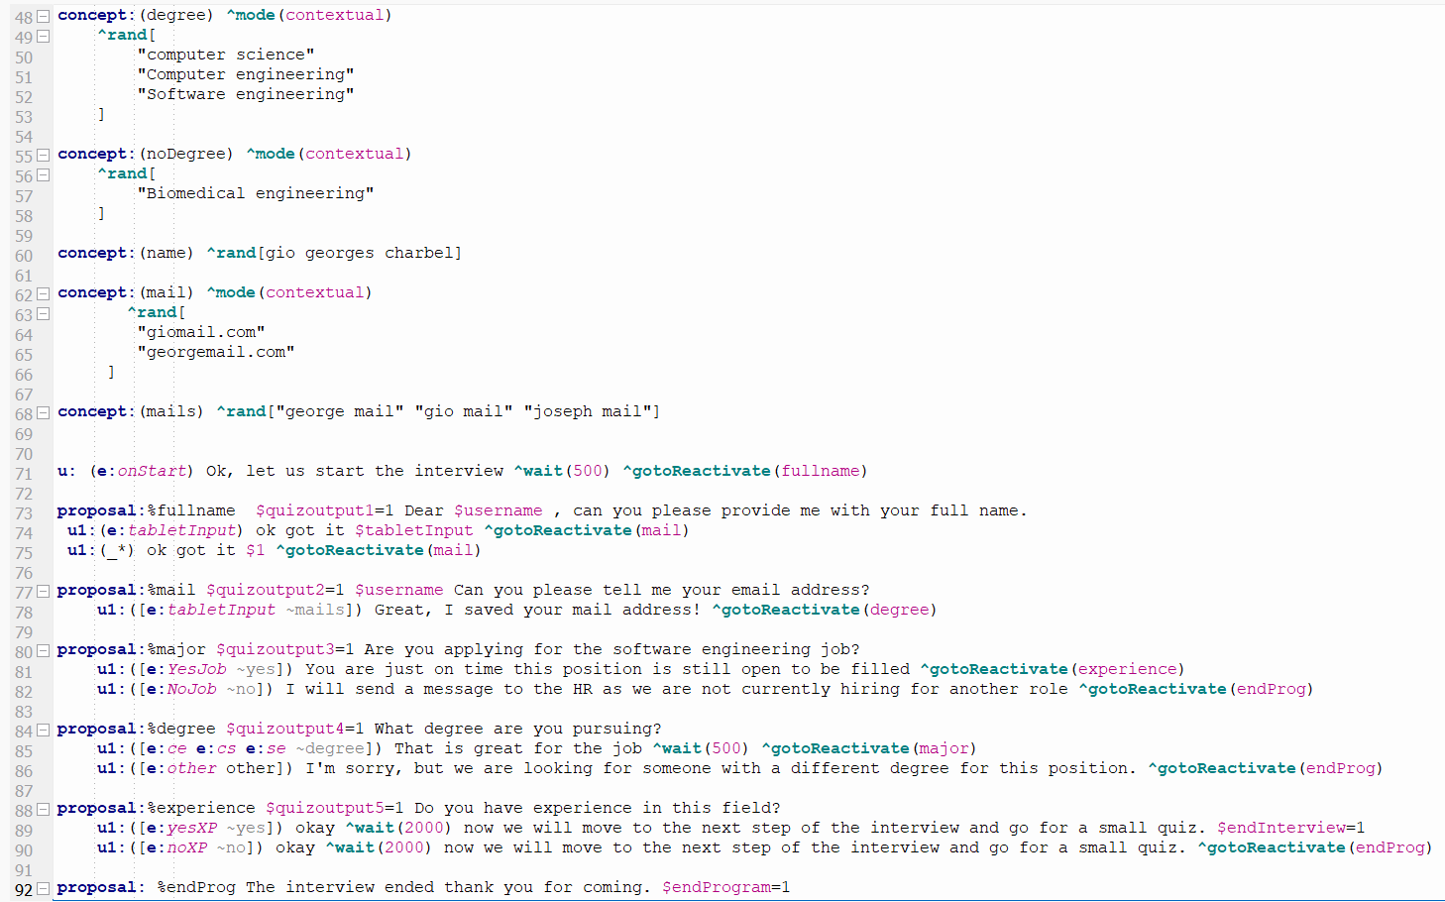
Choregraph Code
Page

Slide 28
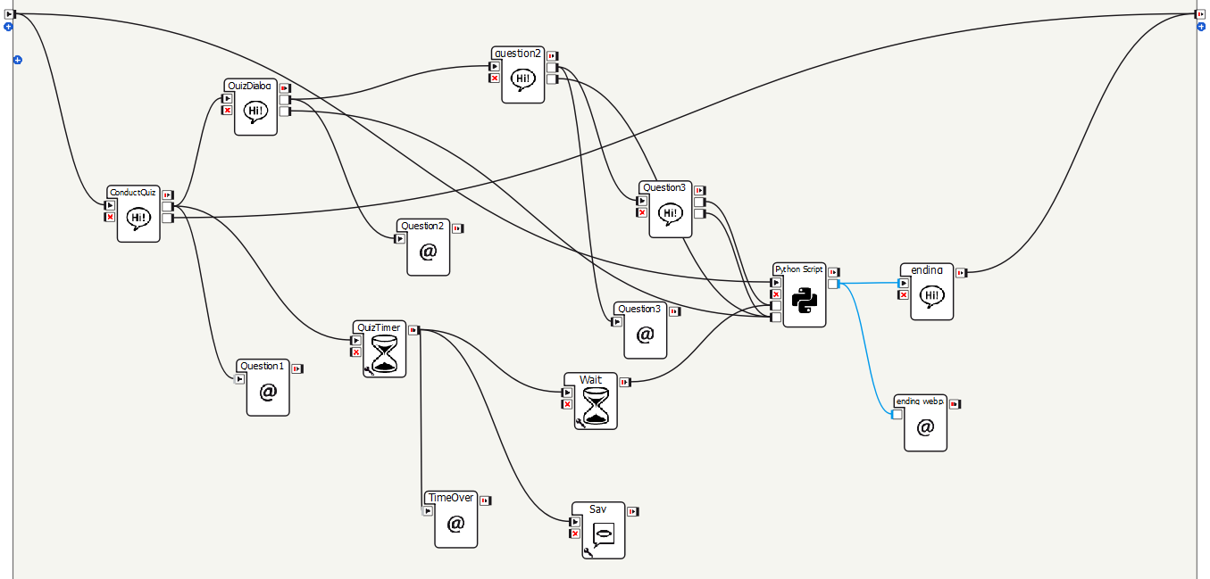
Choregraph Code
Page

Slide 29
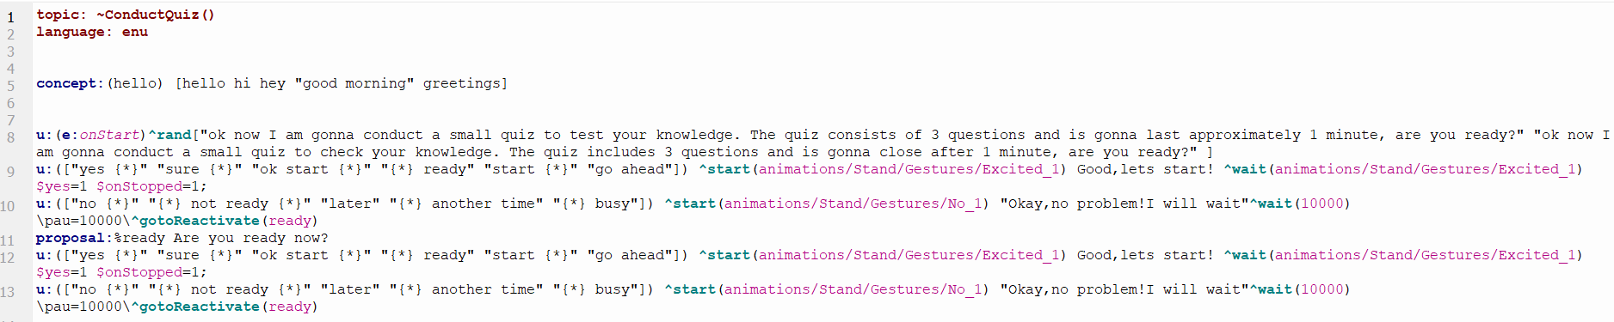
Choregraph Code
Page

Slide 30
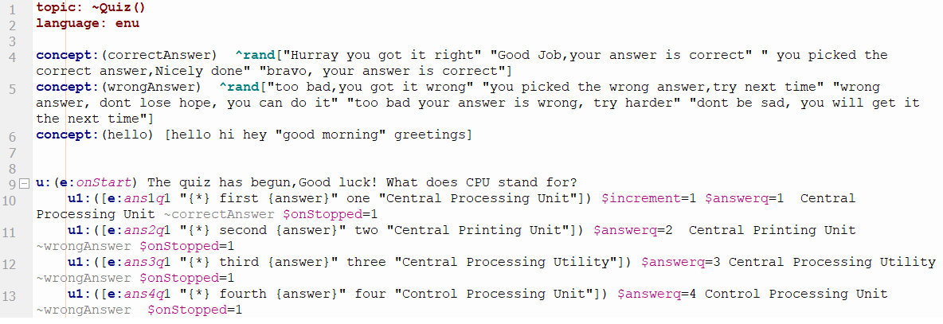
Choregraph Code
Page

Slide 31
08
Conclusion
Page 31

Slide 32
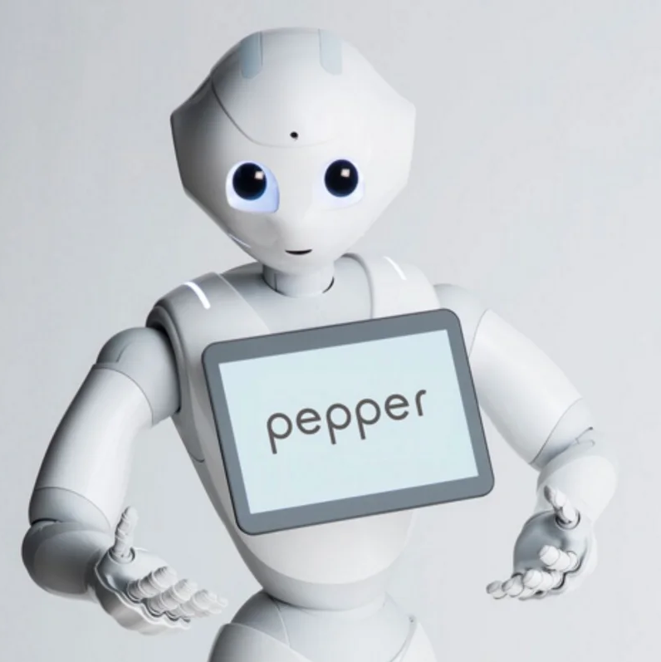
Conclusion
In conclusion, Pepper Robot can transform recruitment by improving efficiency, consistency, and reducing bias. While not a replacement for humans, it’s a valuable tool for high-volume hiring. As technology evolves, are we ready to let robots like Pepper shape the future of recruitment?
Page 32

Slide 33
Thanks!
Do you have any questions?

